Slide 1
Notes:
ALTERNATIVE COVER
Main Heading
Font: Georgia; 28pts
Color: Blue
Character Spacing: Normal
Line spacing: 1pt
Text alignment: Centered
Subheading 1
Font: Arial Bold; 16pts
Color: Blue
Character Spacing: Normal
Line spacing: Exactly
Text alignment: Centered
Subheading 2
Font: Arial; 14pts
Color: Blue
Character Spacing: Normal
Line spacing: Exactly
Text alignment: Centered
Date
Font: Georgia Italic; 16pts
Color: Yellow
Character Spacing: Normal
Line spacing: 1pt
Text alignment: Centered

Slide 2
Defining Economic Development
Economic Development is the expansion of capacities that contribute to the advancement of society through the realization of individual, firm and community potential.
Economic Development is a sustained increase in prosperity and quality of life through innovation, lowered transaction costs, and the utilization of capabilities towards the responsible production and diffusion of goods and services.
Economic development requires effective institutions grounded in norms of openness, tolerance for risk, appreciation for diversity, and confidence in the realization of mutual gain for the public and the private sector.
Economic development is essential to creating the conditions for economic growth and ensuring our economic future.
Notes:
A functional definition to guide public policy and evaluation.

Slide 3


Mission Statement
EDA’s mission is to lead the federal economic development agenda by promoting innovation and competitiveness, preparing American regions for growth and success in the worldwide economy.
As the only federal agency with economic development as its exclusive mission, EDA drives collaborative regional economic development initiatives that lead to job creation.
Notes:
INSIDE PAGE Template
EDA Logo, yellow line and Eagle are part of the background artwork and are not editable (no animation)
Slide Title/Sub-title (should appear in the same place on each slide, centered from top/bottom, right justified next to Eagle)
Slide Title Font: Arial Narrow, Bold, All Caps; 24pts
Color: Blue
Character Spacing: Expanded 2.5pts
Alignment: Left
Line Spacing: Spacing After: 3pts
Slide Sub-title Font: Georgia, Italic; 14pts
Color: Brown
Character Spacing: Normal
Alignment: Right
Animation: none
Heading 1
Font: Arial Narrow, Bold, All Caps; 16pts
Color: Brown
Character Spacing: Expanded 2.5pts
Line Spacing: Spacing After: 3pts
Text alignment: Left
Animation: Fade, after previous, Very fast speed
Paragraph
First line in paragraph: Font: Georgia, Regular; 18pts
Color: Blue
Character Spacing: Normal
Line Spacing: Exactly 23.25
Text alignment: Left
Remaining text in Paragraph: Font: Arial Narrow, Regular; 16pts
Color: Blue
Character Spacing: Expanded 0.6pts
Line Spacing: Exactly 23.25
Text alignment: Left
Animation: Fly in, after previous, from right, Very fast speed
Line
Color: Yellow
Size: 1pt
Line length should be as wide as paragraph above and callout below
Animation: Wipe, after previous, from right, Very fast speed
Call out Text
Font: Georgia, Regular; 20pts
Color: Light Blue
Character Spacing: Normal
Line Spacing: Exactly 30pts
Text alignment: Left
Animation: Fly in, after previous, from right, Very fast speed
Photo Treatment 1
Circle photos are preferred treatment, but must be created in design software such as Adobe Illustrator or Adobe Photoshop
Circle photos should be placed on the right or left side of the slide and should be slightly overlapped.
Circle photo animation: Faded zoom, after previous, Very fast speed

Slide 4



Innovation. Regional Collaboration. Job Creation.
EDA Investments Create Jobs
★
EDA provides economic tools and seed investments to state and local governments, tribal organizations, universities, and non-profits in communities and regions suffering from severe economic distress
★
EDA targets its investments to attract private investment
and support long-term job creation
★
EDA investments are focused on locally-developed, regionally-owned economic development strategies that directly contribute to economic development
★
EDA is helping communities compete in the 21st century by making catalytic investments that support regional competitiveness, innovation, and entrepreneurship
Notes:
• EDA provides catalytic investments that are designed to support competitive projects across the country which will leverage other public and private funds to realize bottom-up regional strategies and economic development goals.
• EDA’s programs provide a portfolio of tools and resources which help support regional competitiveness.
Enables the bureau to fund a range of customized investments specifically developed to meet the strategic priorities of applicant communities rather than being cultivated strictly based on formulas.

Slide 5
Innovation. Regional Collaboration. Job Creation.
Meeting the Full Spectrum of Community Needs
Healthy
Business Ecosystem
Engines of Innovation
Basic Infrastructure
Business Support
Technology Infrastructure
Healthy
Business Ecosystem
Engines of Innovation
Basic Infrastructure
Business Support
Technology Infrastructure
Universities / R&D
Commercialization
Capital
Incubators
Accelerators
Capital
People & Culture
People & Culture
Transportation
Utilities
Broadband
Cellular
Wireless
People & Culture
People & Culture
People & Culture
Notes:
Discuss how EDA’s work hits all of the Secretary’s priorities.

Slide 6
Innovation. Regional Collaboration. Job Creation.
What Is the Return for Communities across the Country and for the U.S. Taxpayer?
EDA investments are transformed into jobs and private-sector investments, fueling sustainable economic growth that raises living standards and improves the quality of life over the long term.
Strong multiplier: Every dollar EDA invests leverages an average of $10 in additional investment. (per third-party study by Rutgers, validated by Grant Thorton)
In FY 2015, EDA awarded approximately $238 million to support 624 investments through its Economic Development Assistance Programs.

Slide 7







Innovation. Regional Collaboration. Job Creation.
EDA Program Portfolio
Public Works
Planning
Local Technical Assistance
Research & National Technical Assistance
PROGRAMS
University Centers
Trade Adjustment Assistance for Firms
Economic Adjustment
Regional Innovation Strategies (America COMPETES RAMI)

Slide 8




Investment Priorities
★ Collaborative Regional Innovation
★ Public/Private Partnerships
★ National Strategic Priorities
★ Global Competitiveness
★ Environmentally-Sustainable Development
★ Economically Distressed and Underserved
Communities
Notes:
Template notes Inside page – Bullet Treatment 2
Top border – see page 2
Photo Treatment 1 – see page 2
Paragraph text
Font: Arial Narrow, Regular; 16pts
Color: Blue
Character Spacing: Expanded 0.6pts
Line Spacing: Exactly 23.25
Text alignment: Left
Animation: Fly in, after previous, from right, Very fast speed
Bullet List Heading
Font: Georgia, Bold; 14pts
Color: Brown
Character Spacing: expand .06pt
Line Spacing: After 6pts
Alignment: Left
Animation: (all bullet components in separate text box to create more dynamic animations): Fly in, from bottom, very fast
Custom Bullet (animation under Bullet Heading)
Color: Dark Blue
Custom Shape: Star
Size: 122%
Animation same as bullet text (see next)
Bullet Text
Font: Arial Narrow, Regular; 18pts
Color: Blue
Character Spacing: Expand 1pt
Line Spacing: 1.5
Alignment: Left
Animation: (all bullet components in separate text box to create more dynamic animations): Fly in, from bottom, very fast

Slide 9



Assistance Criteria
EDA Assistance Criteria
Regions that meet one or more of the following criteria may be eligible for EDA grants
Unemployment rate for the most recent 24-
month period that is at least 1% point higher
than the national average
Per capita income that is 80% or less than the
national average
A special need, such as (but not limited to)
plant closings, natural disasters, or military
base closures
Notes:
Template notes Inside page – Bullet Treatment
Top border – see page 2
Photo Treatment 1 – see page 4
Blue Background Bar
When placing a bulleted list on the page, one option is to add this blue gradient bar behind. Resize to fit evenly behind text.
Animation: Wipe, from left, very fast, with previous (should appear at the same time as the quote)
Bullet Heading
Font: Georgia, Bold; 18pts
Color: Brown
Character Spacing: Expand 1pt
Line Spacing: Space After 12pts
Alignment: Left
Animation: Heading and bullet list in one text box: Fly in, from right, very fast, Text Animation: Animate text all at once; Group text: 1st level
Custom Bullet (animation under Bullet Heading)
Color: Dark Blue
Custom Shape: Star
Size: 122%
Bullet text (animation under Bullet Heading)
Font: Arial Narrow, Regular; 18pts
Color: Blue
Character Spacing: Expand 1pt
Line Spacing: 1.5pt
Alignment: Left

Slide 10
Eligibility
State and local governments
Nonprofit organizations
Institutions of high education
Native American tribal governments
Notes:
Template notes Inside page – Bullet Treatment
Top border – see page 2
Photo Treatment 1 – see page 4
Blue Background Bar
When placing a bulleted list on the page, one option is to add this blue gradient bar behind. Resize to fit evenly behind text.
Animation: Wipe, from left, very fast, with previous (should appear at the same time as the quote)
Bullet Heading
Font: Georgia, Bold; 18pts
Color: Brown
Character Spacing: Expand 1pt
Line Spacing: Space After 12pts
Alignment: Left
Animation: Heading and bullet list in one text box: Fly in, from right, very fast, Text Animation: Animate text all at once; Group text: 1st level
Custom Bullet (animation under Bullet Heading)
Color: Dark Blue
Custom Shape: Star
Size: 122%
Bullet text (animation under Bullet Heading)
Font: Arial Narrow, Regular; 18pts
Color: Blue
Character Spacing: Expand 1pt
Line Spacing: 1.5pt
Alignment: Left

Slide 11
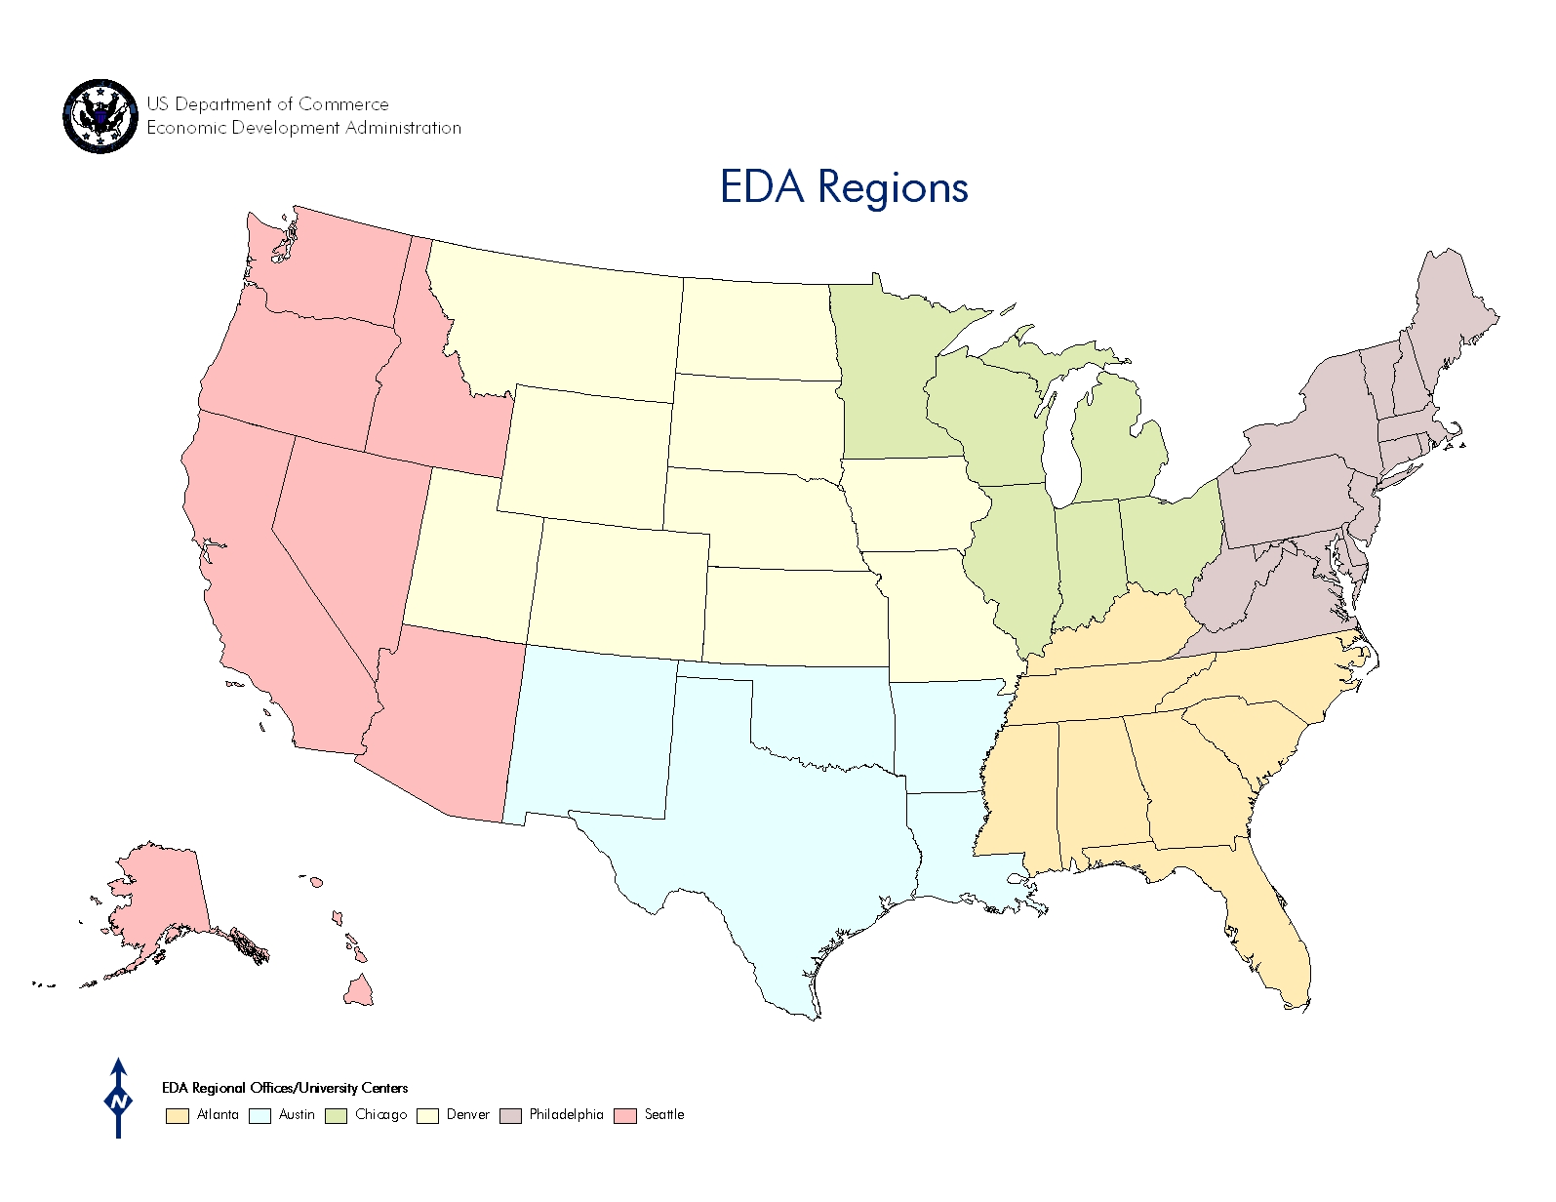
Regional Offices
Seattle
Chicago
Philadelphia
Denver
Austin
Atlanta

Slide 12

Project Example – University Center
Delaware State University (DSU) ’s University Center for Economic Development and Trade (UCEDT)
Founded in 2011, Delaware State University (DSU) ’s University Center for Economic Development and Trade (UCEDT) was created with the goal of promoting and supporting entrepreneurship and workforce development using a $500,000 EDA investment.
As an EDA University Center, building relationships and connections between the university and the economic development community is a key priority. In this role, UCEDT provides technical assistance to local governments, such as feasibility and impact studies, as well as strategic support and guidance on international trade initiatives for Delaware companies.
In 2014, the Center worked to establish First State Moves the Nation, a jobs and business accelerator in Milford. In collaboration with First State Manufacturing and the City of Milford, UCEDT assists businesses participating in the accelerator program with technical assistance and legal services, as well as provides virtual accelerator services.
Notes:
INSIDE PAGE Template
EDA Logo, yellow line and Eagle are part of the background artwork and are not editable (no animation)
Slide Title/Sub-title (should appear in the same place on each slide, centered from top/bottom, right justified next to Eagle)
Slide Title Font: Arial Narrow, Bold, All Caps; 24pts
Color: Blue
Character Spacing: Expanded 2.5pts
Alignment: Left
Line Spacing: Spacing After: 3pts
Slide Sub-title Font: Georgia, Italic; 14pts
Color: Brown
Character Spacing: Normal
Alignment: Right
Animation: none
Heading 1
Font: Arial Narrow, Bold, All Caps; 16pts
Color: Brown
Character Spacing: Expanded 2.5pts
Line Spacing: Spacing After: 3pts
Text alignment: Left
Animation: Fade, after previous, Very fast speed
Paragraph
First line in paragraph: Font: Georgia, Regular; 18pts
Color: Blue
Character Spacing: Normal
Line Spacing: Exactly 23.25
Text alignment: Left
Remaining text in Paragraph: Font: Arial Narrow, Regular; 16pts
Color: Blue
Character Spacing: Expanded 0.6pts
Line Spacing: Exactly 23.25
Text alignment: Left
Animation: Fly in, after previous, from right, Very fast speed
Line
Color: Yellow
Size: 1pt
Line length should be as wide as paragraph above and callout below
Animation: Wipe, after previous, from right, Very fast speed
Call out Text
Font: Georgia, Regular; 20pts
Color: Light Blue
Character Spacing: Normal
Line Spacing: Exactly 30pts
Text alignment: Left
Animation: Fly in, after previous, from right, Very fast speed
Photo Treatment 1
Circle photos are preferred treatment, but must be created in design software such as Adobe Illustrator or Adobe Photoshop
Circle photos should be placed on the right or left side of the slide and should be slightly overlapped.
Circle photo animation: Faded zoom, after previous, Very fast speed

Slide 13
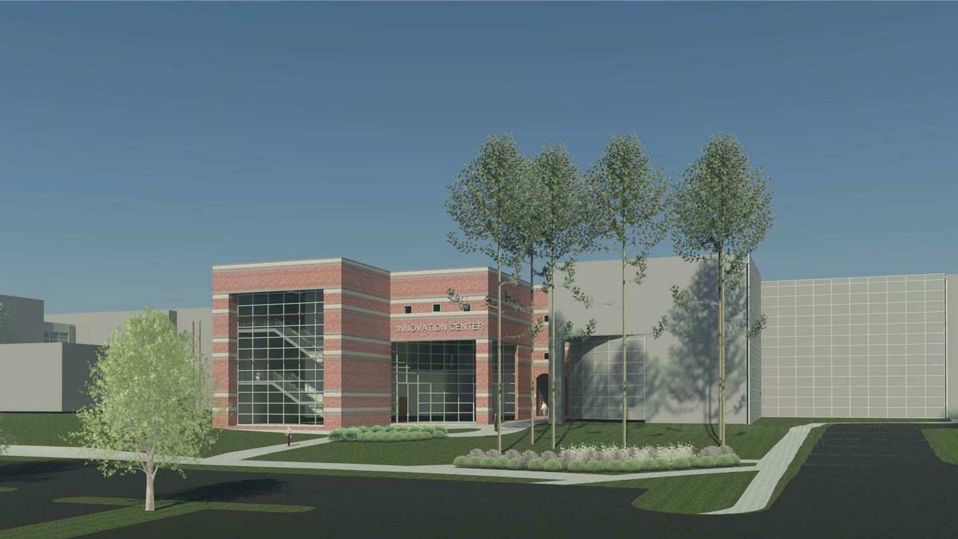
Project Example- Public Works
University of Alabama in Huntsville
The city of Huntsville has a vibrant economy, and is the heart of one of the fastest growing regions in Alabama. A strong driver of this economic growth and prosperity is research and development in the defense and aerospace sectors, which employ thousands of residents in Huntsville’s 15-county commuter shed.
In September 2015, EDA awarded $3 million to the University of Alabama in Huntsville (UAH) to construct the Innovation to Invention Center (I2C). The I2C will be an incubator/innovation hub and accelerator program that will provide physical facilities and services to support inventors, entrepreneurs, high-tech companies, and partners in the innovation process. Building on that investment, EDA later awarded $500,000 to UAH through the 2015 i6Challenge to fund the Growth & Acceleration of Products (GAP) project. A virtual proof-of-concept center, the GAP project will unite resources at UAH and within the government and high-tech business community to bring "shelved" technologies into the marketplace.
This regional development initiative will leverage UAH assets to grow the region’s innovation capacity. The I2C is projected to result in the creation of 365 new jobs and more than $30 million in private investment. The estimated long-term economic impact includes the creation of 1,460 high-tech jobs, 7,300 indirect jobs for skilled/unskilled labor, and a total wage impact of $453 million by the year 2024.
Notes:
INSIDE PAGE Template
EDA Logo, yellow line and Eagle are part of the background artwork and are not editable (no animation)
Slide Title/Sub-title (should appear in the same place on each slide, centered from top/bottom, right justified next to Eagle)
Slide Title Font: Arial Narrow, Bold, All Caps; 24pts
Color: Blue
Character Spacing: Expanded 2.5pts
Alignment: Left
Line Spacing: Spacing After: 3pts
Slide Sub-title Font: Georgia, Italic; 14pts
Color: Brown
Character Spacing: Normal
Alignment: Right
Animation: none
Heading 1
Font: Arial Narrow, Bold, All Caps; 16pts
Color: Brown
Character Spacing: Expanded 2.5pts
Line Spacing: Spacing After: 3pts
Text alignment: Left
Animation: Fade, after previous, Very fast speed
Paragraph
First line in paragraph: Font: Georgia, Regular; 18pts
Color: Blue
Character Spacing: Normal
Line Spacing: Exactly 23.25
Text alignment: Left
Remaining text in Paragraph: Font: Arial Narrow, Regular; 16pts
Color: Blue
Character Spacing: Expanded 0.6pts
Line Spacing: Exactly 23.25
Text alignment: Left
Animation: Fly in, after previous, from right, Very fast speed
Line
Color: Yellow
Size: 1pt
Line length should be as wide as paragraph above and callout below
Animation: Wipe, after previous, from right, Very fast speed
Call out Text
Font: Georgia, Regular; 20pts
Color: Light Blue
Character Spacing: Normal
Line Spacing: Exactly 30pts
Text alignment: Left
Animation: Fly in, after previous, from right, Very fast speed
Photo Treatment 1
Circle photos are preferred treatment, but must be created in design software such as Adobe Illustrator or Adobe Photoshop
Circle photos should be placed on the right or left side of the slide and should be slightly overlapped.
Circle photo animation: Faded zoom, after previous, Very fast speed

Slide 14

Project Example- Economic Adjustment Assistance
University of the Virgin Islands (UVI)
When building a house, you start with a blueprint; when rebuilding your economy, you start with a map. In 2012, the U.S. Virgin Islands’ largest single employer, Hovensa, closed its oil refinery in St. Croix, leaving more than 2,000 people out of work. To deal with this devastating blow, the Territory needed to take stock and locate its assets.
In 2014, EDA awarded $500,000 to assist in the development of a geographic information system (GIS) map of the physical locations of regional assets in Saint Croix. The GIS asset mapping will serve as a critical first step in organizing the resources that can leverage and support integrated workforce and economic development initiatives.
In addition, this project also brings a unique opportunity for collaboration between two universities, Delaware State University and the University of the Virgin Islands (UVI). UVI will assist in the data collection, project team formation, penetration into business and social communities and overall analysis. Delaware State University, an EDA University Center, will use its expertise to evaluate the significance and impact of each major type of regional asset.
Notes:
INSIDE PAGE Template
EDA Logo, yellow line and Eagle are part of the background artwork and are not editable (no animation)
Slide Title/Sub-title (should appear in the same place on each slide, centered from top/bottom, right justified next to Eagle)
Slide Title Font: Arial Narrow, Bold, All Caps; 24pts
Color: Blue
Character Spacing: Expanded 2.5pts
Alignment: Left
Line Spacing: Spacing After: 3pts
Slide Sub-title Font: Georgia, Italic; 14pts
Color: Brown
Character Spacing: Normal
Alignment: Right
Animation: none
Heading 1
Font: Arial Narrow, Bold, All Caps; 16pts
Color: Brown
Character Spacing: Expanded 2.5pts
Line Spacing: Spacing After: 3pts
Text alignment: Left
Animation: Fade, after previous, Very fast speed
Paragraph
First line in paragraph: Font: Georgia, Regular; 18pts
Color: Blue
Character Spacing: Normal
Line Spacing: Exactly 23.25
Text alignment: Left
Remaining text in Paragraph: Font: Arial Narrow, Regular; 16pts
Color: Blue
Character Spacing: Expanded 0.6pts
Line Spacing: Exactly 23.25
Text alignment: Left
Animation: Fly in, after previous, from right, Very fast speed
Line
Color: Yellow
Size: 1pt
Line length should be as wide as paragraph above and callout below
Animation: Wipe, after previous, from right, Very fast speed
Call out Text
Font: Georgia, Regular; 20pts
Color: Light Blue
Character Spacing: Normal
Line Spacing: Exactly 30pts
Text alignment: Left
Animation: Fly in, after previous, from right, Very fast speed
Photo Treatment 1
Circle photos are preferred treatment, but must be created in design software such as Adobe Illustrator or Adobe Photoshop
Circle photos should be placed on the right or left side of the slide and should be slightly overlapped.
Circle photo animation: Faded zoom, after previous, Very fast speed

Slide 15
Regional Innovation Strategies Program
Authorized by the America COMPETES Reauthorization Act of 2010, as amended by the Revitalize American Manufacturing and Innovation Act of 2014 (15 U.S.C. §3722)
Encompasses
  the i6 Challenge;
  the Seed Fund Support Grant competition; and
  Science & Research Park Feasibility & Planning grants (2014 only)
Overwhelming demand: evidence of community interest and needs
2016 RIS Program FFO closed 11:59pm ET on June 24
Notes:
The Regional Innovation Strategies (RIS) Program is one of our bread-and-butter, core programs, and it’s what brings us here today.
This authorization, which is open to a broader set of applicants and communities than EDA’s traditional programs, creates opportunities for a new set of EDA stakeholders
Generated huge demand: have been able to fund only 15% of submitted applications, but 83% were fundable.
Eric will dive into these details in his part of the presentation
As a special note: the 2016 RIS Program solicitation is currently open—see your packets
Accepting applications until 11:59pm ET on June 24

Slide 16
The RIS Program
Past & Present, in Brief
i6 Challenge
  Funding for proof-of-concept and commercialization activities that help turn ideas and inventions into products and companies
  Retooled in 2014 to be more accessible and inclusive
Seed Fund Support Program
  Supports feasibility, planning, formation, or launch of cluster-based seed capital
  Created in 2014 in response to Senate appropriations report language
Notes:
For those unfamiliar with the RIS program, it currently encompasses two competitions: the i6 Challenge and the Seed Fund Support Grant competition.
We retooled the i6 Challenge in 2014:
EDIT:
Previously, the i6 Challenge provided six awards of $1m each, matched 1:1 by the grantees; one in each of the six EDA regions (hence the name)
Based on stakeholder feedback, we retooled to allow more communities the opportunity to compete by lowering the maximum award, increasing the number of awards, and making it a truly national program.
Now: $500k maximum Federal funding, matched 1:1, but we encourage grantees to apply for the amount that they need to fill the gaps in their regions.
For example, we awarded the Montana Economic Revitalization and Development Institute (MERDI) just under $150,000 for mentoring and prototyping programs to fill gaps in the innovative manufacturing industry in Montana.
While we look at geographic distribution, there’s no set number of grants per region.
We created the SFS Program in 2014.
We provide operational support for feasibility, planning, creation, launch, and expansion of equity-based seed funds.
This fills a much needed gap in many regions for funding for early-stage companies—and no other Federal funding supports these types of activities.
DON’T SAY THAT THIS ISN’T FOR CAPITALIZATION UNLESS ASKED
And, if asked, answer that we structured the program this way because raising capital from within the region creates a stronger ecosystem and because we wanted to complement, not duplicate, SBA’s SBIC and Treasury’s SSBCI programs

Slide 17

Technology Commercialization Carolina
University of North Carolina
Opportunity
  Promising ideas abound across university system
  Great inventions need business acumen
  Technology companies across state poised for growth
Technology Commercialization Carolina is:
  Patent, Market and Funding Opportunity Research to determine viability
  StartUp Consulting & Workshops to provide a solid business foundation
  Entrepreneur Technical Assistance Program to accelerate non-University high growth firms
Impact and Notable Metrics
  30 non-UNC clients from across state including Historically Black and American Indian Universities
  Series A financing; companies incorporated; patents pending; increased access to existing resources
  Flanders Filters, Shure Foods, P&A group
TCC.unc.edu

Slide 18
UNIVERSITY EXAMPLES
Regional Innovation Strategies Program Investments
University of North Dakota
  Launching a seed fund to support the growing UAS cluster surrounding Grand Forks, ND
  UND has become a hot bed for aviation research, especially UAS technologies
Louisiana Tech University
  Further integrate the I-20 Corridor Maker’s Innovation Network with interdisciplinary marker-spaces, business development services, and entrepreneurship programing
  Grow a network of regional partners to extend the maker network and increase investment across the corridor
See more at https://www.eda.gov/oie/ris/prior-years.htm

Slide 19
Grantee Successes
Selected Anecdotes
University of Virginia, Virginia Innovation Partnership (FY12)
  Funded 36 projects for a total of more than $1.6m
  12 new ventures launched
  More than $4.3m in follow-on funding raised
New Orleans BioInnovation Center (NOBIC) (FY14)
  55 clients served, who reported creating 136 jobs, filing 115 patent applications, raising $19.7m in funding, and reaching $6.7m in sales
  175 technical assistance meetings, 45 mentoring sessions, 7 SBIR applications supported
Craig Buerstatte
Deputy Director, Office of Innovation and Entrepreneurship
oie@eda.gov
Notes:
The RIS program is new, and we’re looking forward to the impact metrics and reports that we’ll receive from our 2014 i6 cohort in 2017 and to analyzing the standardized metrics that we require grantees to report on for all our grantees.
But we have some outcome metrics from a couple of our grantees that I want to quickly share
These are two examples from the applications that we’ve been able to fund.

Slide 20
RIS Applications
2014 & 2015
i6
S&RP
SFS
Notes:
I want to quickly go back to the map of all RIS applications.

Slide 21
RIS Grantees
2014 & 2015
i6
S&RP
SFS
Notes:
In two years, we’ve made grants in 33 States and in Puerto Rico.
As Craig mentioned, these programs vary widely and are tailored to fill gaps in and leverage resources of the local and regional ecosystems they serve.

Slide 22
Regional Office Contacts
Atlanta Regional Office
Alabama, Florida, Georgia, Kentucky, Mississippi, North Carolina, South Carolina, Tennessee
H. Philip Paradice, Jr., Regional Director
401 West Peachtree Street, NW
Suite 1820
Atlanta, GA 30308-3510
P: 404-730-3002
F: 404-730-3025
E: hparadice@eda.gov
Austin Regional Office
Arkansas, Louisiana, New Mexico, Oklahoma, Texas
Jorge Ayala, Regional Director
903 San Jacinto
Suite 206
Austin, Texas 78701
P: 512-381-8150
F: 512-499-0478
E: jayala@eda.gov
Chicago Regional Office
Illinois, Indiana, Michigan, Minnesota, Ohio, Wisconsin
Jeannette P. Tamayo, Regional Director
230 South Dearborn Street
Suite 3280
Chicago, IL 60604-1512
P: 312-353-8143
F: 312-353-8575
E: jtamayo@eda.gov
Denver Regional Office
Colorado, Iowa, Kansas, Missouri, Montana, North Dakota, Nebraska, South Dakota, Utah, Wyoming
Angela Belden Martinez, Regional Director
1244 Speer Boulevard
Suite 431
Denver, CO 80204
P: 303-844-4715
F: 303-844-3968
E: amartinez@eda.gov
Philadelphia Regional Office
Connecticut, Delaware, District of Columbia, Maine, Maryland, Massachusetts, New Hampshire, New Jersey, New York, Pennsylvania, Rhode Island, Vermont, Virginia, West Virginia, Puerto Rico, Virgin Islands
Linda Cruz-Carnall, Regional Director
The Curtis Center
601 Walnut Street, Suite 140 South
Philadelphia, PA 19106-3323
P: 215-597-4603
F: 215-597-1063
E: LCruz-Carnall@eda.gov
Seattle Regional Office
Alaska, Arizona, California, Hawaii, Idaho, Nevada, Oregon, Washington, American Samoa, Northern Mariana Islands, Guam, Federated States of Micronesia, Rep. of Marshall Islands, Rep. of Palau
A. Leonard Smith, Regional Director
915 Second Avenue
Room 1890
Seattle, WA 98174
P: 206-220-7660
F: 206-220-7669
E: asmith@eda.gov
Notes:
INSIDE PAGE Template
EDA Logo, yellow line and Eagle are part of the background artwork and are not editable (no animation)
Slide Title/Sub-title (should appear in the same place on each slide, centered from top/bottom, right justified next to Eagle)
Slide Title Font: Arial Narrow, Bold, All Caps; 24pts
Color: Blue
Character Spacing: Expanded 2.5pts
Alignment: Left
Line Spacing: Spacing After: 3pts
Slide Sub-title Font: Georgia, Italic; 14pts
Color: Brown
Character Spacing: Normal
Alignment: Right
Animation: none
Heading 1
Font: Arial Narrow, Bold, All Caps; 16pts
Color: Brown
Character Spacing: Expanded 2.5pts
Line Spacing: Spacing After: 3pts
Text alignment: Left
Animation: Fade, after previous, Very fast speed
Paragraph
First line in paragraph: Font: Georgia, Regular; 18pts
Color: Blue
Character Spacing: Normal
Line Spacing: Exactly 23.25
Text alignment: Left
Remaining text in Paragraph: Font: Arial Narrow, Regular; 16pts
Color: Blue
Character Spacing: Expanded 0.6pts
Line Spacing: Exactly 23.25
Text alignment: Left
Animation: Fly in, after previous, from right, Very fast speed
Line
Color: Yellow
Size: 1pt
Line length should be as wide as paragraph above and callout below
Animation: Wipe, after previous, from right, Very fast speed
Call out Text
Font: Georgia, Regular; 20pts
Color: Light Blue
Character Spacing: Normal
Line Spacing: Exactly 30pts
Text alignment: Left
Animation: Fly in, after previous, from right, Very fast speed
Photo Treatment 1
Circle photos are preferred treatment, but must be created in design software such as Adobe Illustrator or Adobe Photoshop
Circle photos should be placed on the right or left side of the slide and should be slightly overlapped.
Circle photo animation: Faded zoom, after previous, Very fast speed

