Slide 1
EDA’s New Grant Forms and Application Process
December 8, 2015

Slide 2
Overview of new Process For Public WORKS and ECONOMIC ADJUSTMENT ASSISTANCE PROGRAMS

Slide 3
Benefits OF New Process
New Process applies to Public Works and Economic Adjustment Assistance Programs
New proposal format allows potential applicants to submit a conceptual idea without the time and expense of a full application
Proposals that are found to be responsive and proceed to an application will be assigned an EDA POC for technical assistance
New Forms apply to all EDA programs
New, shorter forms opposed to one large form mean less confusion and more clarity for applicants
Continued focus on quick processing times and prompt feedback on application status

Slide 4
Eliminating application deadlines
No more deadlines
EDA will accept applications at any point and remains committed to timely feedback and decisions
To make our process easier and more accessible, a short proposal form will be accepted before a full application is required
EDA is committed to responding within 30 days of receiving your application
If the regional office decides to advance your proposal, they will ask you to submit the application within about 60 days.
An EDA point-of-contact will be assigned to support the application development

Slide 5
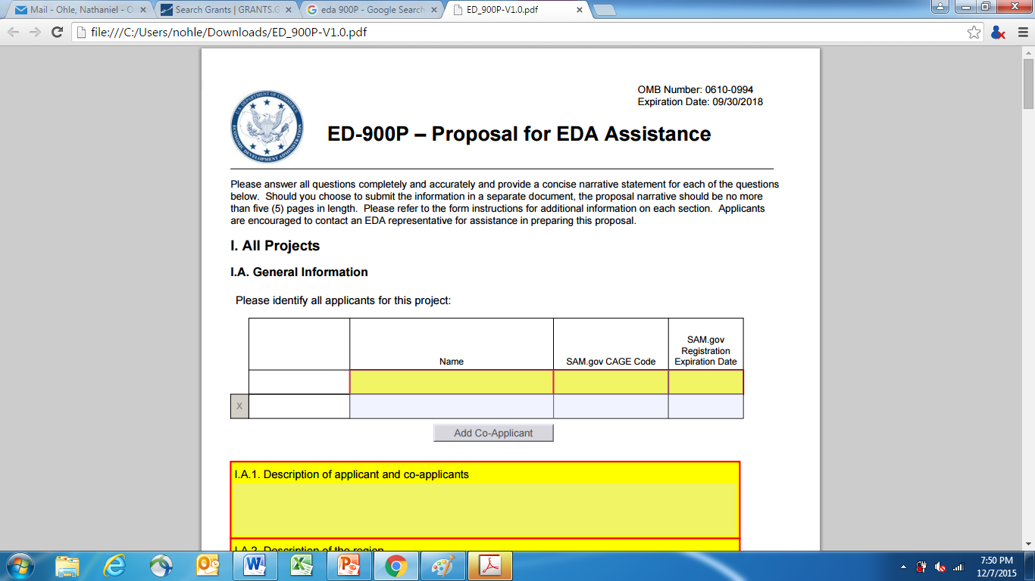
New Proposal form - EDA 900P

Slide 6
Overview of new forms Effective as of October 1, 2015

Slide 7
Pre-FY 2016 FORMS
One form used for all EDA programs
Generated confusion among applicants as to which parts to complete
Made it difficult for the applicant to reproduce parts of the form that needed to be signed by multiple people (i.e. Exhibit A – Assurances of Compliance)
Generated enormous amounts of unnecessary paper when printed.
The single form was not flexible for use with EDA’s changing suite of programs and initiatives
Contained outdated information and broken links to external sites

Slide 8
new Application forms
General Application for EDA Programs (ED-900)
Questions that pertain to all EDA programs, including Project Narrative questions (geographic coverage, scope of work, potential impacts), budget narrative, and eligibility questions.
Additional EDA Assurances (ED-900A)
Specific assurances that applicants need to provide in order to apply for EDA funding.
Beneficiary Information Form (ED-900B)
Specific assurances required from beneficiaries of EDA funding, including documentation of estimated jobs and private investment resulting from the EDA project.

Slide 9
new Application forms
EDA Application Supplement for Construction Programs (ED-900C)
Information required from construction applicants as part of a full application after the proposal has been approved.
Requirements for Design and Engineering Assistance (ED-900D)
Information required from design/engineering only applicants as part of a full application after the proposal has been approved.
Calculation of Estimated Relocation and Acquisition Expenses (ED-900E)
Provides detailed breakdown of the estimated total for line item 3 ("relocation expenses and payments") of Form SF-424C, 'Budget Information - Construction Programs to comply with the Uniform Relocation Act.

Slide 10
new Application forms
Supplement for Revolving Loan Fund Applications (ED-900F)
Information required to evaluate the competitiveness of a revolving loan fund application.
Proposal for EDA Assistance (ED-900P) – Only applies to PW and EAA
New general questions to allow applicants to give a broad overview of their proposed project/scope of work.
Environmental Narrative and Applicant Certification Clause
Template to guide the applicant through the development of an environmental narrative that satisfies the requirements of the National Environmental Policy Act (NEPA).

Slide 11
Regional Office Contact Information
Atlanta: (404) 730-3002
Austin: (512) 381-8144
Chicago: (312) 353-8143
Denver: (303) 844-4715
Philadelphia: (215) 597-4603
Seattle: (206) 220-7660
Each office will announce additional dates for webinars or conference calls with regional stakeholders to begin in January.
Thank you!

