Slide 1
2018 University Center Competition Austin Regional Office June 18th, 2018

Slide 2
Meeting Agenda
Program Overview
Allocation
Eligibility
Award Period
Match Requirements
Application Requirements
Facilities and Administrative (F&A) Indirect Costs
Application Review Criteria and Process
Review and Selection Process
Past Competition
Tools and Resources
Notice of Funding Opportunity (NOFO) link:
https://www.grants.gov/web/grants/view-opportunity.html?oppId=305793

Slide 3
Program overview
The University Center (UC) Program – Enables institutions of higher education to establish and operate programs focused on leveraging university assets to foster regional economic development.
Builds regional economic ecosystems through science, technology, engineering and math (STEM) skills that support innovation and high-growth entrepreneurship.
Collaborates with other EDA partners by providing
expertise and technical assistance to develop,
implement and support regional strategies.
Results in job creation, high-skilled regional talent
pools, and business expansion in a region’s
innovation clusters.
Notes:
Aligns with DOC Strategic Plan 2018-2020.

Slide 4
Program Allocation
Austin Regional Office
Receives $1,128,500 total appropriations per year
Will fund approximately 10 University Centers at equal amounts
Award amount will be between $100,000 and $125,000 per year
Notes:
In comparison, DRO received approximately $1.4 million during the last competition in 2013 and received 30 applications.
Annual awards will generally range from $80,000- 200,000.

Slide 5
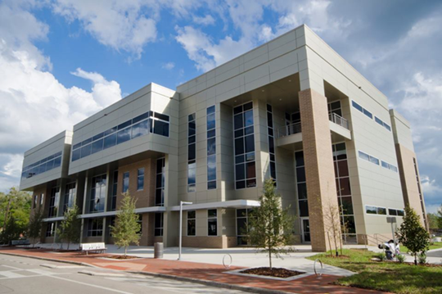
Eligibility
Eligible Applicants
Accredited Institutions of Higher Education
Community Colleges or Junior Colleges
Consortium of Accredited Institutions of Higher Education
University-Affiliated Research Institutions
See Notice of Funding Opportunity for eligibility details.
Notes:
• For “Consortium of Accredited Institutions of Higher Education - one accredited institution must be identified as Lead Applicant
• For “University-Affiliated Research Institutions – entity must demonstrate support of a university
• Non-profit organizations (must be in good standing, in partnership with consortium, and affiliated/directed by an accredited institution of higher education)
Please read the eligible applicants section of the Notice of Funding Opportunity for provisions.

Slide 6
Award Period
5-year period of performance
Funding beyond the initial year will be dependent upon the availability of funds and upon the recipients’ satisfactory performance and progress in achieving milestones and program goals as determined by EDA and expressed in writing.

Slide 7
Match requirements
Application Matching Requirements
EDA will fund 50 percent of the total project cost unless significant distress criteria is met and documented for the project impact.
In-kind contributions are allowed.
A detailed 5-year plan for local match must be included with the application.
First year match must be fully committed, available, and unencumbered at the time the application is submitted.
Notes:
In-kind contributions - must be directly related to project.
Amount and nature of the match contribution (cash or in-kind) is considered during merit review.
Important to get prior approval from EDA if using other federal funds as match. The statue for those funds must state clearly that they can be used as a federal match. The Delta Regional Authority is an example of such funds.
Since funds are awarded each year the commitment of match is required only for year one. However, the application should include information and budgets for the total 5 year award period. We will cover that in the next slides.
Local match can be documented by a board resolution or letter signed by a person authorized to financially bind that entity.
Please refer to pg. 10 Section C.2. of the NOFO for more information on match.
Amount and nature of the match contribution are considered during merit review.

Slide 8
APPLICATION REQUIREMENTS
Due Sunday, July 15th 2018 at 11:59 PM EST
Required Application Forms
As outlined on Grants.gov: SF-424, SF-424A, SF-424B, CD-511, SF-LLL, ED-900, ED-900A
Project Narrative
No more than 10 pages of double-spaced text including attachments
Provides for a five-year scope of work and for a timeline for implementation during the five-year period of performance, including benchmarks to gauge program progress and includes the following items:
Cover Page
Program Focus
Service Region
Scope of Work
Supporting Information
Project Matches EDA priorities
Project Timeline
Project Sustainability
Notes:
Grant must be filled out and submitted at grants.gov

Slide 9
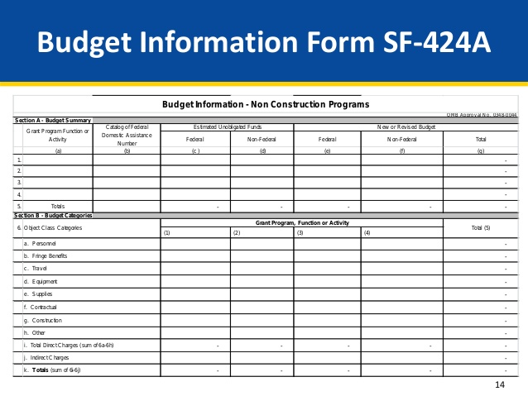
APPLICATION REQUIREMENTS
Budget
SF-424A for entire 5-year award period.
Attach 5 separate itemized budgets
including federal, non-federal cash and
in-kind and total amounts allocated
to each budget line item for each of
the 5 years in the period of performance.
Budget Narrative
Program Income: Must be added to funds committed to the project, and must be used to further eligible program activities before expiration of the five-year period of performance
Staffing Plan (Resumes of Key Project Staff <2 pages)
System for Award Management (SAM) Registration
Intergovernmental Review / State’s Single Point of Contact (SPOC)

Slide 10
F&A or indirect cost rate may amount to no more than 20 percent of the total project cost.
IndiRECt Cost
If facilities & administrative (F&A) or indirect costs are included in the project budget...
Submit a copy of current indirect cost rate agreement or documentation establishing that it has a pending proposal from the federal cognizant agency, OR
If applicant does not have a current indirect cost rate agreement by a federal cognizant agency, it may propose facilities and administrative costs in its budget. However, applicant must prepare and submit a cost allocation plan and rate proposal or a negotiated indirect cost rate, OR
If applicant has never had a negotiated indirect cost rate may elect to charge a de minimis rate of 10 percent of total direct costs.
Notes:
Clarification on 10% de minimis - The applicant should include a statement in its budget narrative if the applicant does not have a current F&A cost rate agreement, has not submitted an F&A cost rate proposal, or elects the 10 percent de minimis rate.
The maximum allowable F&A or indirect cost rate is 20% for applicant’s submitting an approved rate or cost allocation so that maximum is regardless of what your rate may be identified on your agreement /plan.

Slide 11
Application Review criteria
25%
Applicant’s Capacity to Execute the of Scope of Work
The Responsiveness to the Objectives of the NOFO
Project Alignment with EDA’s Investment Priorities
35%
40%
Notes:
Applications will be reviewed based on three rating criteria...project’s alignment with investment priorities will make up 25% of the total score, Applicant’s capacity to execute scope of work is 35% of the total score and the project’s responsiveness to the objectives of the NOFO will make up the remaining 40%.
The next 4 slides will go into more detail on each these.

Slide 12
Alignment with investment priorities
Projects MUST address one or more of the following EDA University Center’s Investment Priorities:
RECOVERY AND RESILIENCE
CRITICAL INFRASTRUCTURE
WORKFORCE DEVELOPMENT AND MANUFACTURING
EXPORTS AND FOREIGN DIRECT INVESTMENT
See complete description of Investment Priorities in the Notice of Funding Opportunity at https://www.eda.gov/about/investment-priorities/uc-rnta/
Notes:
The application should clearly explain how the project addresses one or more of EDA University Center’s current funding priorities.
Recovery and Resilience – Refers to projects that assist with economic resilience such as business continuity activities or long-term recovery from natural disasters or severe downturns in the economy.
Critical Infrastructure – These are projects that establish fundamental building blocks for business and industry to create or grow a prosperous and innovative economy. Could be any kind of soft infrastructure such as training, programs, etc.
Workforce Development & Manufacturing – supports planning and implementation of workforce training centers or other skills-development related facilities. This can also be activities that encourage job creation through business expansion in manufacturing or activities that support advanced manufacturing. ADVANCED MANUFACTURING - advanced manufacturing of innovate, high-value products.
Exports and Foreign Direct Investment - projects or programs that support growth in U.S. exports and increase investment by foreign-held companies.
These priorities can be found on EDA’s website, which provides more detail on each priority. Please make sure you are using the current investment priorities under the UC program.

Slide 13
Applicant Capacity
Application should demonstrate applicant’s capacity to execute the scope of work
DEMONSTRATE ORGANIZATIONAL CAPACITY
FEASIBILITY OF THE PROJECT
SUSTAINABILITY AND DURABILITY OF PROJECT
FOSTER JOB CREATION AND PROMOTES PRIVATE INVESTMENT
Notes:
The application should describe the applicant’s capacity in all four of these areas. All 4 factors are weighted equally.

Slide 14
RESPONSIVENESS TO PROGRAM OBJECTIVES
Well-defined geographic area and benefit distressed communities
Activities which foster regional economic ecosystems
Advance entrepreneurship,
Enhance the commercialization of research,
Foster a high-skilled workforce and contribute to an innovation environment and infrastructure, and
Develop a highly networked regional talent pool of researchers, academics, entrepreneurs, suppliers, and investors with expertise across disciplines and along the supply chains relevant to the region’s innovation clusters
Drive regional economic development and strategies.
Highlight working with existing partners and priorities
Notes:
A EDA University Center should create and nurture regional economic ecosystems through STEM skill development, workforce training opportunities, applied research and development, technology commercialization, and targeted activities that cultivate entrepreneurship and improve regional economic development.
Geographic areas do NOT need to be contiguous or defined by political boundaries but should be a cohesive area capable of undertaking proposed activities.
EDA encourages projects that create or nurture regional economic ecosystems through activities that support entrepreneurship, enhance commercialization of research, foster a high-skilled workforce and other efforts that contribute to an innovation environment. ADD STEM HERE
Proposed activities should link existing regional strategies to further economic development for the entire region.

Slide 15
RESPONSIVENESS TO PROGRAM OBJECTIVES
Leverage existing university/intuitional assets
Staff, research, technological capabilities, partnerships, etc.
Demonstrate sustainability of proposed program
Before, during, and after performance period
Engage EDA stakeholders and partners
Economic Development Districts & Tribal Governments
Federal Agencies
State Offices & Workforce Dev. Boards
Cities and Counties
Non-Profit Organizations
Economic Development Organizations
Business and Industry Associations
Notes:
The purpose of the UC program is to leverage the existing University resources, so please explain all the ways your program will achieve this.
For previously funded UC that are applying, you should explain in the narrative how the new program is different than or builds upon past EDA-funded programs or activities.
Competitive applications will document strong partnerships. Partnership letters should identify the role the support organization has in the program and detail contributions.
Sustainability should be clearly addressed, this is often a weak element in the UC applications. In your narratives explain future revenues or finance models that will support your programs after the award has been closed-out.

Slide 16
Review & Selection process
NOFO Published
June
Awards Announced
September
Receipt of Application
July
Technical Review
July
Investment Review Committee
August
Grant’s Officer Decision
August
Applications Due: July 15, 2018 at 11:59pm ET (10:59pm CT and 9:59pm MT)
Applications will be submitted through grants.gov at https://www.grants.gov/web/grants/view-opportunity.html?oppId=305793
Notes:
Subject to the availability of funding, successful applicants should expect to receive awards within approximately 75 calendar days from the application closing date and times set out in this NOFO on pg. 1.
Please pay close attention to the Content and Form of Application Section starting on page 11 of the NOFO, which describes at great length how to address the required forms and narratives.
Limitation of assistance that can be provided by the EDA offices from this point on, strictly TA?????
SAM.gov registration needs to be completed as soon as possible, please let us know if the registration has not been completed by the end of June.

Slide 17
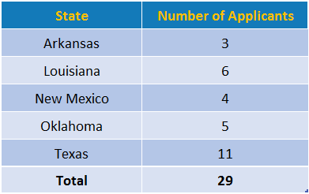
past competitions
2013 UC Competition Applications

Slide 18
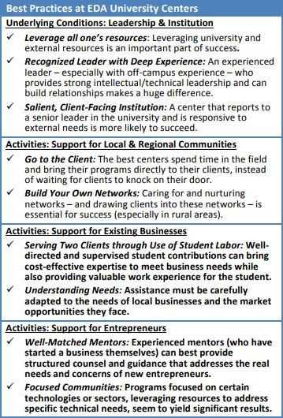
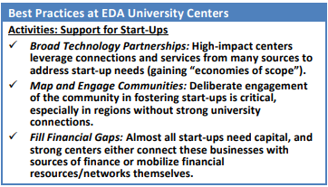
Tools and Resources
EDA’s University Center page:
https://www.eda.gov/programs/university-centers/
Best Practices & Other Resources:
https://www.eda.gov/files/programs/university-centers/uc-tools/Evaluation-of-UC-Best-Practices.pdf
https://www.eda.gov/tools/
Notes:
EDA’s website has a dedicated University Center page provides the direct link to the Denver’s UC competition through grants.gov. Your encourages to use this link rather than searching through the grants.gov website. The UC web page also includes a report on EDA’s UC Best Practices that may be particularly helpful when establishing performance measures. This clip you see here is from that report, there’s some really good data collected from past UCs. There are success stories of past and present UCs.
EDA’s website also has links to interactive economic development tools such as the StatsAmerica (measures distress), the Innovation Index and Industry Cluster mapping through RAIN, so please check those out.

Slide 19
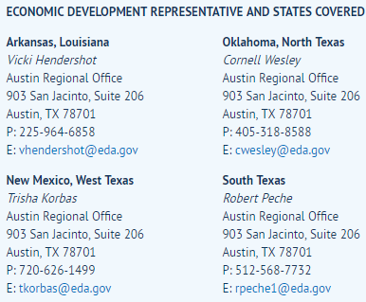
CONTACT INFORMATION
University Center POC:
Sally Waley
Senior Economic Development Specialist
U.S. Department of Commerce
Economic Development Administration
Austin Regional Office
903 San Jacinto Blvd.
Suite 206
Austin, Texas 78704
512-381-8141 | swaley@eda.gov
EDA Mission: To lead the federal economic development agenda by promoting innovation and competitiveness, preparing American regions for growth and success in the worldwide economy.

