Slide 1
2018 University Center Competition
Denver Regional Office

Slide 2
Meeting Agenda
Program Overview
Allocation
Eligibility
Award Period
Match Requirements
Application Requirements
Facilities and Administrative (F&A) Costs
Application Review Criteria
Review and Selection Process
Tools and Resources
Notice of Funding Opportunity (NOFO) link:
https://www.grants.gov/web/grants/view-opportunity.html?oppId=305794

Slide 3
Program overview
The University Center (UC) Program – Enables institutions of higher education to establish and operate programs focused on leveraging university assets to foster regional economic development.
Builds regional economic ecosystems through science, technology, engineering and math (STEM) skills that support innovation and high-growth entrepreneurship.
Collaborates with other EDA partners by providing
expertise and technical assistance to develop,
implement and support regional strategies.
Results in job creation, high-skilled regional talent
pools, and business expansion in a region’s
innovation clusters.

Slide 4
Program Allocation
The total University Center Program allocation for FY 2018 is $7.4 million, through the Consolidated Appropriations Act, 2018 (P.L. 115-141).
Denver Regional Office Awards:
Will receive $1,380,000 of EDA’s total appropriation per year.
Will fund approximately 10 awards.
Denver Regional Office | Serving: Colorado, Iowa (excluding Muscatine and Scott counties), Kansas, Missouri, Montana, Nebraska, North Dakota, South Dakota, Utah, and Wyoming.

Slide 5
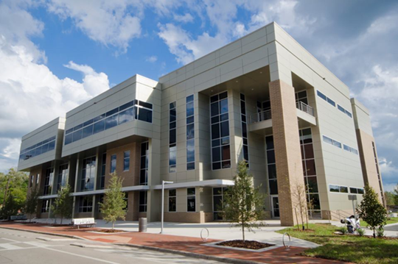
Eligibility
Eligible Applicants
Accredited Institutions of Higher Education
Community Colleges or Junior Colleges
Consortium of Accredited Institutions of Higher Education
University-Affiliated Research Institutions
See Notice of Funding Opportunity for eligibility details.

Slide 6
Award Period
Period of Performance:
Awards will be for a 5-year period of performance.
Selected University Centers will NOT compete for 2nd -5th funding years.
Funding:
Initial funding period will be for Year 1.
Matching funds for the project must be committed for at least Year 1.
Funding beyond the initial first year will be dependent upon the availability of funds and recipient performance.

Slide 7
Match requirements
Application Matching Requirements
EDA will fund 50 percent of the total project cost.
In-kind contributions are allowed.
Other federal funds may be considered match if authorized by statute (requires EDA’s prior approval).
Local match must be committed at the time the application is submitted
(only first year match amount required).

Slide 8
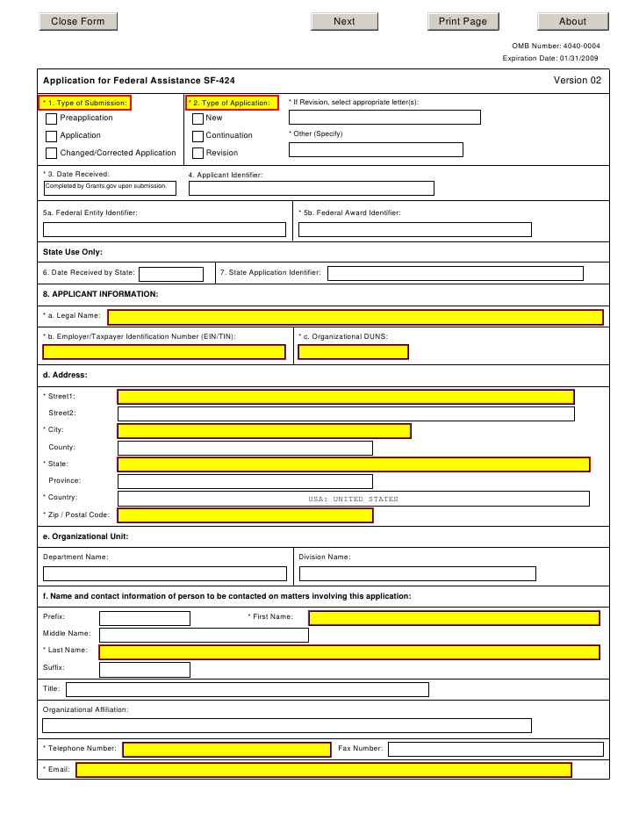
APPLICATION REQUIREMENTS
Required Application Forms
Project Narrative
No more than 10 pages of double-spaced text including attachments but not cover page.
Provides for a five-year scope of work and for a timeline for implementation during the five-year period of performance, including benchmarks to gauge program progress and includes the following items:
Cover Page
Program Focus
Service Region
Scope of Work
Supporting Information
Project Fits w EDA priorities
Project Timeline
Project Sustainability

Slide 9
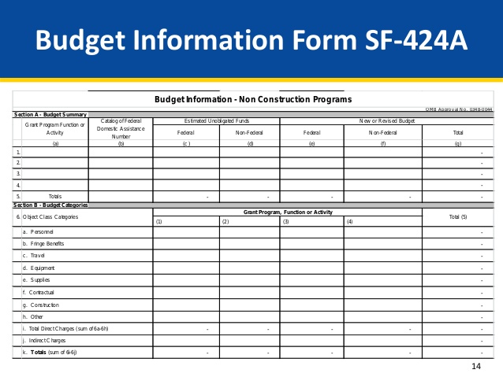
APPLICATION REQUIREMENTS
Budget Narrative
SF-424A for entire 5-year award period.
Attach 5 separate itemized budgets
including federal, non-federal cash and
in-kind and total amounts allocated
to each budget line item for each of
the 5 years in the period of performance.
Staffing Plan (Resumes of Key Project Staff) for each of the five years
System for Award Management (SAM) Registration
Intergovernmental Review / State’s Single Point of Contact (SPOC)
Applies to Iowa, Missouri, North Dakota and Utah

Slide 10
Facilities & administrative (F&A) Costs
IndiRECt Costs
If F&A or indirect costs are included in the project budget...
Submit a copy of F&A agreement or documentation establishing that it has a pending proposal from the federal cognizant agency, OR
If applicant does not have a current F&A agreement by a federal cognizant agency, it may propose facilities and administrative costs in its budget. However, applicant must prepare and submit a cost allocation plan and rate proposal or a negotiated F&A rate, OR
If applicant has never had a negotiated F&A rate may elect to charge a de minimis rate of 10 percent of modified total direct costs.
F&A or indirect cost rate may amount to no more than 20 percent of the total project cost.
See page 17 of NOFO Section D.2.d.iv for details.

Slide 11
Application Review criteria

Slide 12
Alignment with investment priorities
Projects MUST address one of more of the following EDA Investment Priorities:
RECOVERY AND RESILIENCE
CRITICAL INFRASTRUCTURE
WORKFORCE DEVELOPMENT AND MANUFACTURING
EXPORTS AND FOREIGN DIRECT INVESTMENT
See complete description of Investment Priorities in the Notice of Funding Opportunity at https://eda.gov/about/investment-priorities.

Slide 13
Applicant Capacity
Four Equally Weighted Factors:
FOSTERS JOB CREATION AND PROMOTES PRIVATE INVESTMENT
VALIDATES FEASIBILITY OF THE PROJECT
DESCRIBES SUSTAINABILITY AND DURABILITY OF PROJECT
DEMONSTRATES ORGANIZATIONAL CAPACITY

Slide 14
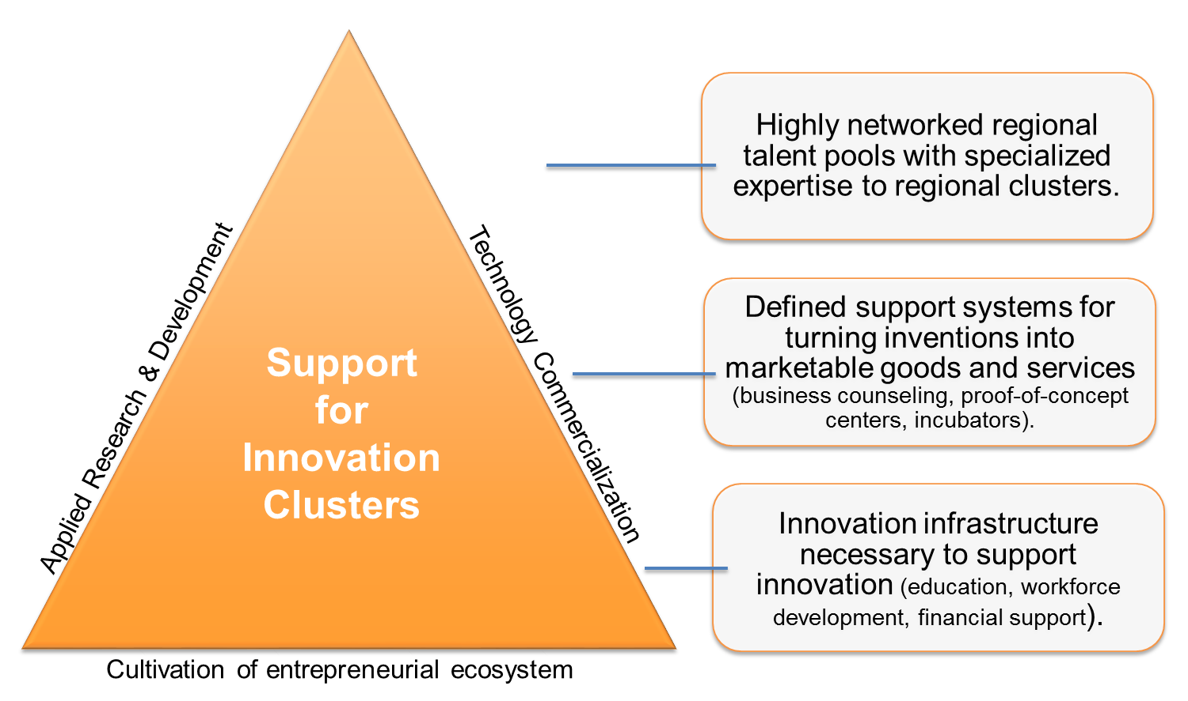
RESPONSIVENESS TO PROGRAM OBJECTIVES
Describe a well-defined geographic area and benefit distressed communities.
Foster regional economic
ecosystems.
Drive regional economic
development and
strategies.
Regional Ecosystems

Slide 15
RESPONSIVENESS TO PROGRAM OBJECTIVES
Leverage University assets.
Engage EDA stakeholders and partners.
Demonstrate sustainability of proposed program.
Economic Development Districts & Tribal Governments
Federal Agencies
State Offices & Workforce Dev. Boards
Cities and Counties
Non-Profit Organizations
Economic Development Organizations
Business and Industry Associations

Slide 16
Review & Selection process
NOFO Published
Awards Announced
Receipt of Application
Technical Review
Investment Review Committee
Grant’s Officer Decision
Applications Due: July 15, 2018 at 11:59pm ET (10:59pm CT and 9:59pm MT)
Applications will be submitted through grants.gov at https://www.grants.gov/web/grants/view-opportunity.html?oppId=305794.

Slide 17
DRO University Centers
2013 - 2018
Kansas State University
University of Northern Iowa
Iowa State University of
Science and Technology
Curators of University of Missouri
- Kansas City
North Dakota State University
Research and Technology Park
University of Wyoming
Southeast Missouri State University
University of Kansas Center
for Research

Slide 18
Tools and Resources
University Center Tools
www.eda.gov/programs/university-centers/
www.eda.gov/tools/
Denver Regional Office Application Link to Grants.gov
EDA Investment Priority Descriptions
EDA Report on
UC Best Practices
UC Highlights & Success Stories
StatsAmerica
(measures economic distress)
-Innovation Index
Regional Innovation Accelerator Network (RIAN)
- Industry Cluster Mapping

Slide 19
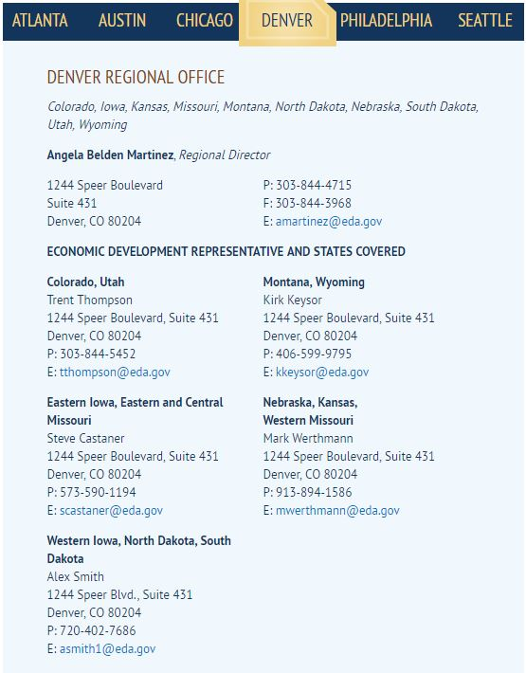
CONTACT INFORMATION
University Center POC:
Jane Reimer
Community & Economic Development Planner
U.S. Department of Commerce
Economic Development Administration
Denver Regional Office
1244 Speer Boulevard, Suite 431
Denver, CO 80204
Tel. 303.844.4090 / jreimer@eda.gov
EDA Mission: To lead the federal economic development agenda by promoting innovation and competitiveness, preparing American regions for growth and success in the worldwide economy.

