Slide 1
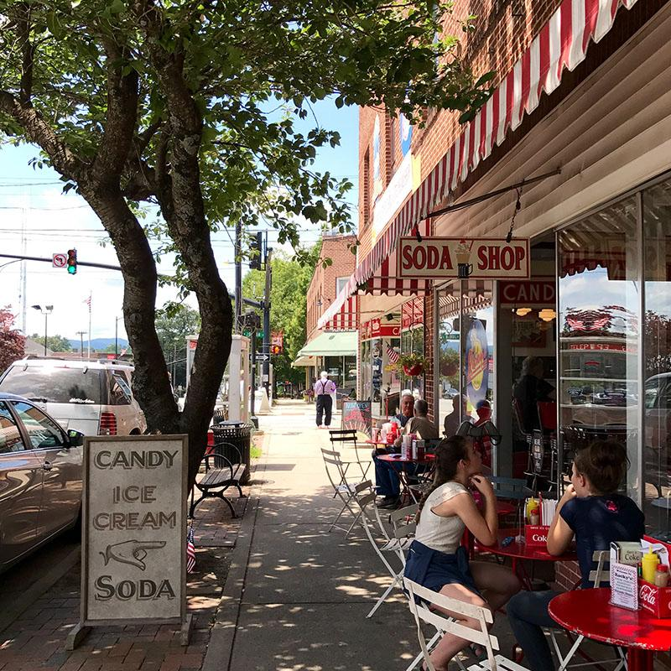
EDA Webinar
May 8, 2019

Slide 2
Agenda
Welcome & Introductions – Bernadette Grafton, EDA
Project Background – Mark Little, NCGrowth
Webtool Demo – Carolyn Fryberger, NCGrowth
Community Perspectives
Shannan Campbell, Hillsborough NC
Brent Frazier, Pelican Rapids MN
Local Government Perspective – Jonathan Morgan, UNC School of Government
Financial Institution Perspective – Jeanne Bonds, Richmond Federal Reserve
Next Steps and Partnership – Carolyn Fryberger
Q&A
Notes:
2 min: Welcome & Introductions – Bernadette Grafton, EDA
2 min: Project Background – Mark Little, NCGrowth
7 min: Webtool Demo – Carolyn Fryberger, NCGrowth
5 min: Community Perspective – Shannan Campbell, Hillsborough NC
5 min: Community Perspective – Brent Frazier, Pelican Rapids MN
5 min: Local Government Perspective – Jonathan Morgan, UNC School of Government
5 min: Financial Institution Perspective – Jeanne Bonds, Richmond Federal Reserve
3 min: Next Steps and Partnership – Carolyn Fryberger
15 min: Q&A

Slide 3
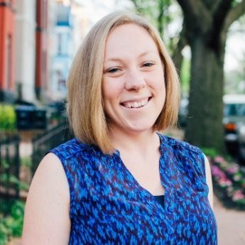
Bernadette Grafton, EDA

Slide 4
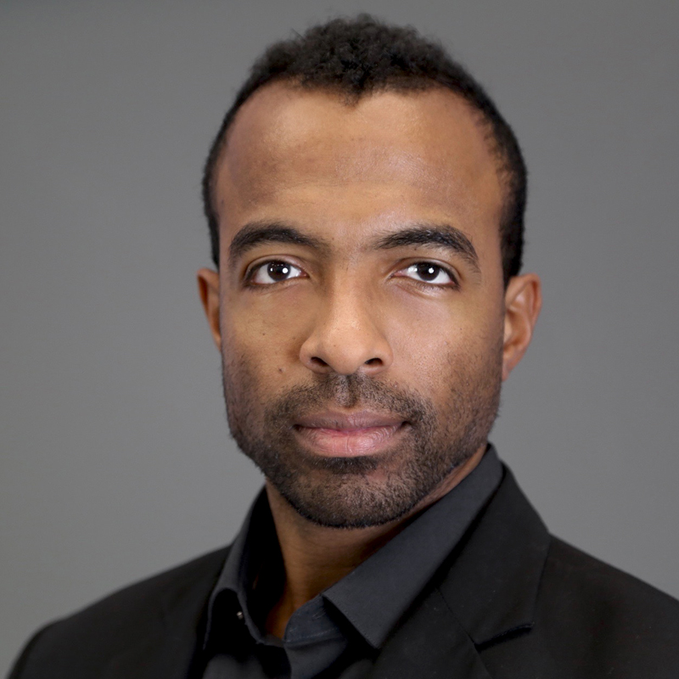
Mark Little, NCGrowth

Slide 5
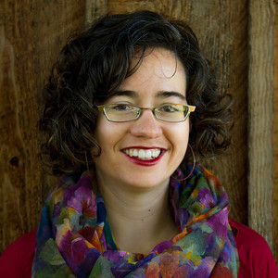
Carolyn Fryberger, NCGrowth

Slide 6
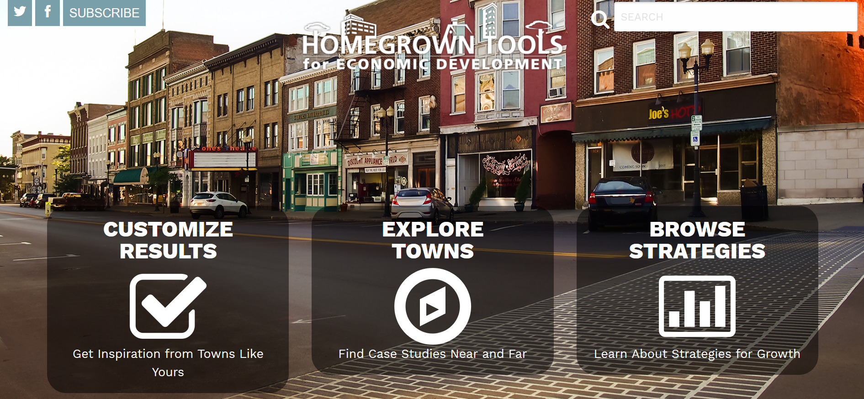
www.homegrowntools.unc.edu

Slide 7
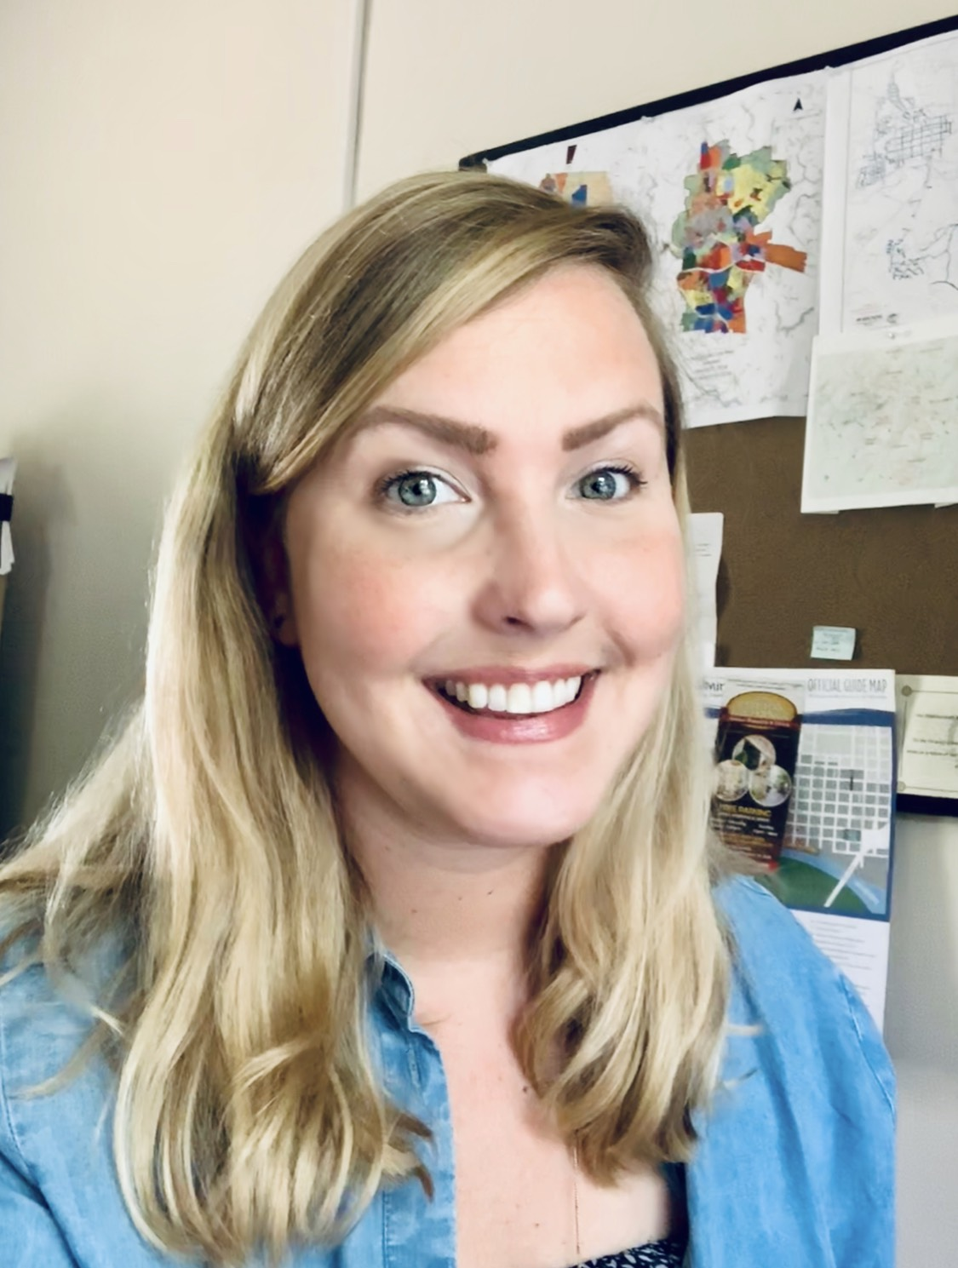
Shannan Campbell, Hillsborough NC
Notes:
WILL SPEAK IN PERSON FROM KENAN CENTER

Slide 8
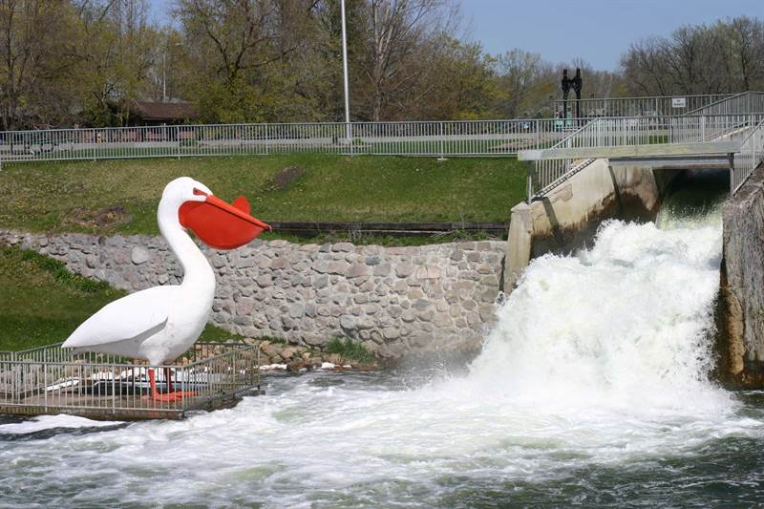
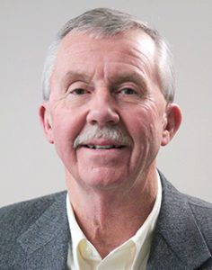
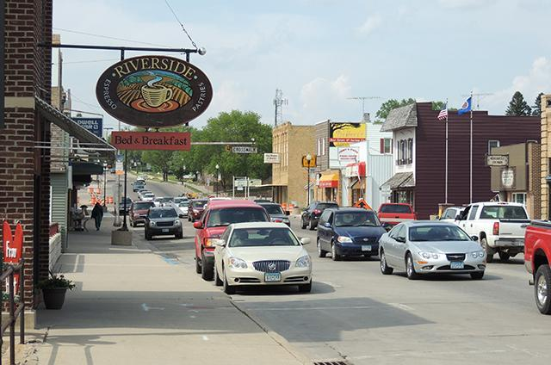
Brent Frazier, Pelican Rapids MN
Notes:
WILL CALL IN

Slide 9
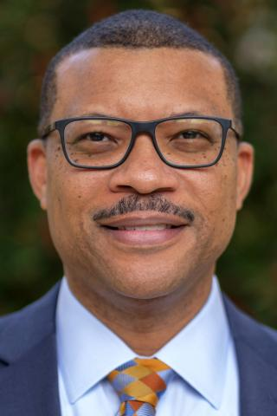
Jonathan Morgan, UNC School of Government
Notes:
WILL CALL IN

Slide 10
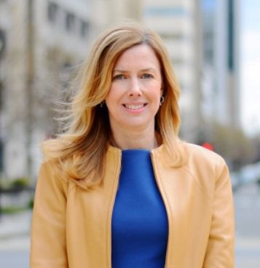
Jeanne Bonds, Richmond Federal Reserve
Notes:
WILL SPEAK IN PERSON FROM KENAN CENTER

Slide 11
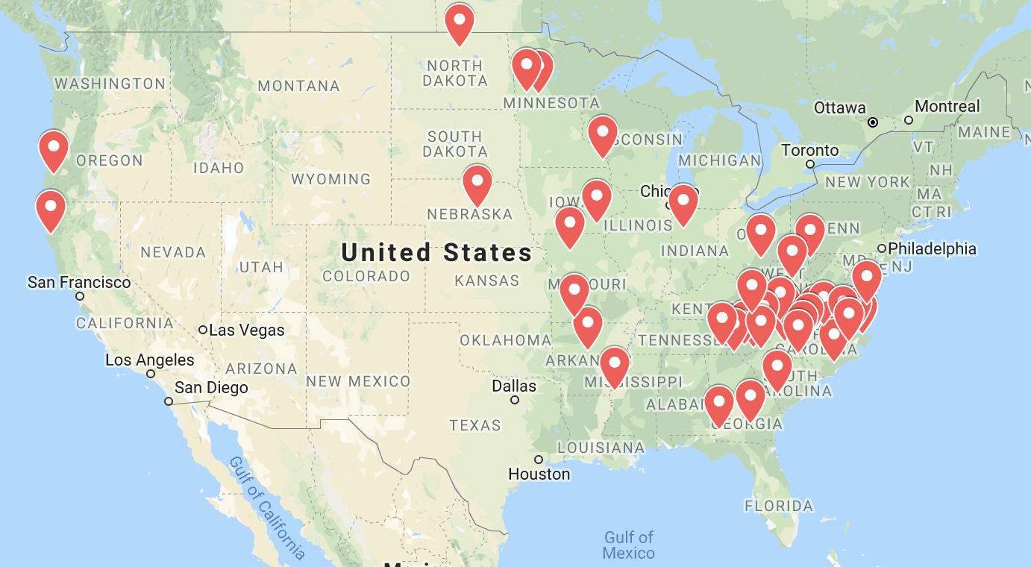
Next Steps and Partnership Opportunities
New Case Studies
Promotion
Contact Carolyn Fryberger to get involved:
Carolyn_Fryberger@unc.edu
919-843-7553

Slide 12
Q & A
Contact info:
Carolyn Fryberger
Economic Development Manager
NCGrowth
Carolyn_Fryberger@unc.edu
919-843-7553
www.ncgrowth.unc.edu
@NCGrowth

